Slide 1
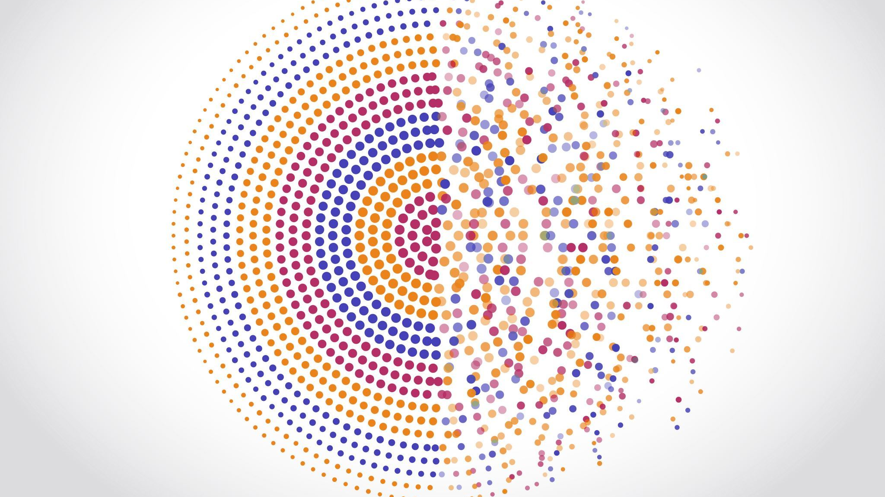
Said Moussadeq
DSC530, Bellevue University
03-01-2024

Slide 2
Research questions
Is sleep quality related to improved scores of mental health?
Is it possible that loneliness may have negative impact on mental health?
Does having more money actually affect the mental state?
Does exercise contribute to improved well-being?
Is diet related to improved score of mental health?

Slide 3
Dataset
Title: Meaning in life: a major predictive factor for loneliness comparable to health status and social connectedness:
The dataset includes scores for predictors of loneliness, including summary scores of sociodemographic, lifestyles, self-rated health status questionnaires and cognitive constructs about meaning in life .
Year:2020
Location: Universitat de Barcelona Facultat de Medicina, Institut Guttmann-
link: https://data.mendeley.com/datasets/zy39mdzxpg/2

Slide 4
Variables:
- Level of Education: Education level
- Family income corrected by family size and structure: Income Corrected, normalizing by the corresponding family poverty threshold from the Catalan population (IDESCAT)
- Nutrition: Mediterranean Diet Adherence screener (MeDAS) (Schröder et al., 2010)
- Exercise: Using the International Physical Activity Questionnaire (IPAQ) in the short version (Craig et al., 2003)
- Sleep Quality: Jenkins Sleep Evaluation Questionnaire (JSEQ, Jenkins et al., 1988)
- Social Interaction: Employing 4 out of the 12 items from the LUBBEN Social Network Scale (LSNS) (Lubben, 1998), which do not contain subjective appreciation of the quality of the interactions and are restricted to number and frequency
- Mental Health: Using the PHQ-4 questionnaire (Kroenke), consisting of questions on depressive and anxiety symptoms
- Loneliness: Sum of scores from the three UCLA loneliness scale items (UCLA_1 + UCLA_2 + UCLA_3)

Slide 5
Histograms and outliers

Slide 6
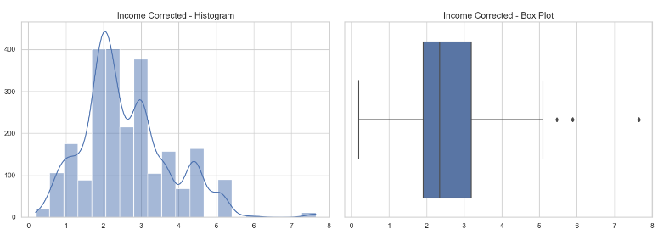
Income Corrected: The distribution seems skewed, with a concentration in lower income brackets. Income Corrected has 12 outliers. These outliers represent individuals with significantly higher corrected incomes.

Slide 7
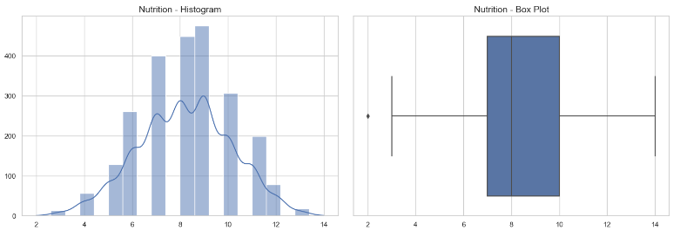
Nutrition: The distribution appears relatively normal but might have slight skewness towards higher nutrition scores. Outliers, there is only 1 outlier. Outliers could be investigated to ensure they're not data entry errors and possibly adjusted or removed if skewing analysis.

Slide 8
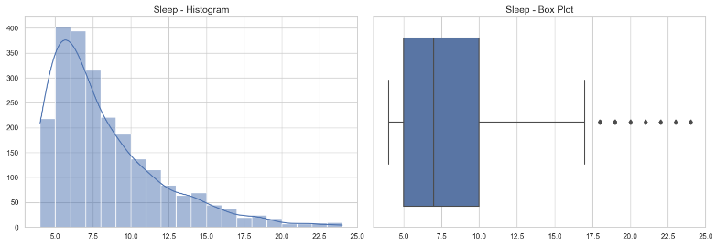
Sleep: This variable shows a concentration around a specific range of sleep quality scores, with a total of 33 outliers on both lower and higher ends. Extremely low or high sleep scores might indicate unusual sleep patterns or data recording errors.

Slide 9
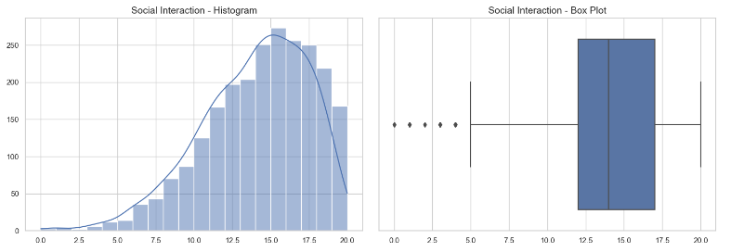
Social Interaction: The distribution seems to have a peak with 16 outliers at the lower end, indicating individuals with very low social interaction. These outliers might represent genuine cases of social isolation or incorrect data.

Slide 10
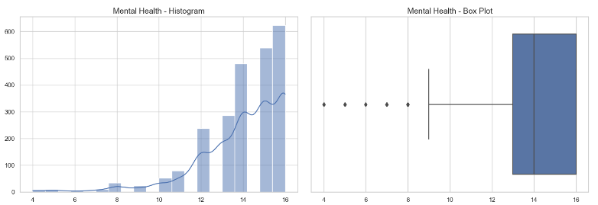
Mental Health: The distribution is skewed towards higher mental health scores, with 33 outliers at both ends. Low scores are of particular interest when studying mental health issues.

Slide 11
Physical Health: Similar to mental health, the distribution is skewed towards higher scores, with 47 outliers at the low end. These could represent individuals with significant health challenges. Outlier handling should consider the importance of these data points to the research question.

Slide 12
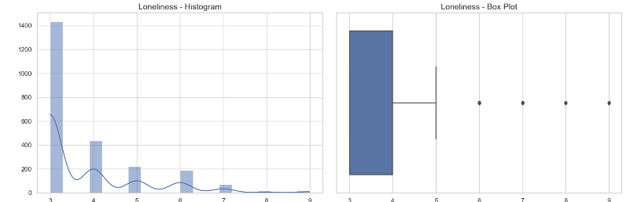
Loneliness: The distribution is skewed, with 34 outliers on the higher end representing individuals experiencing high levels of loneliness. These points are crucial for studies on loneliness.

Slide 13
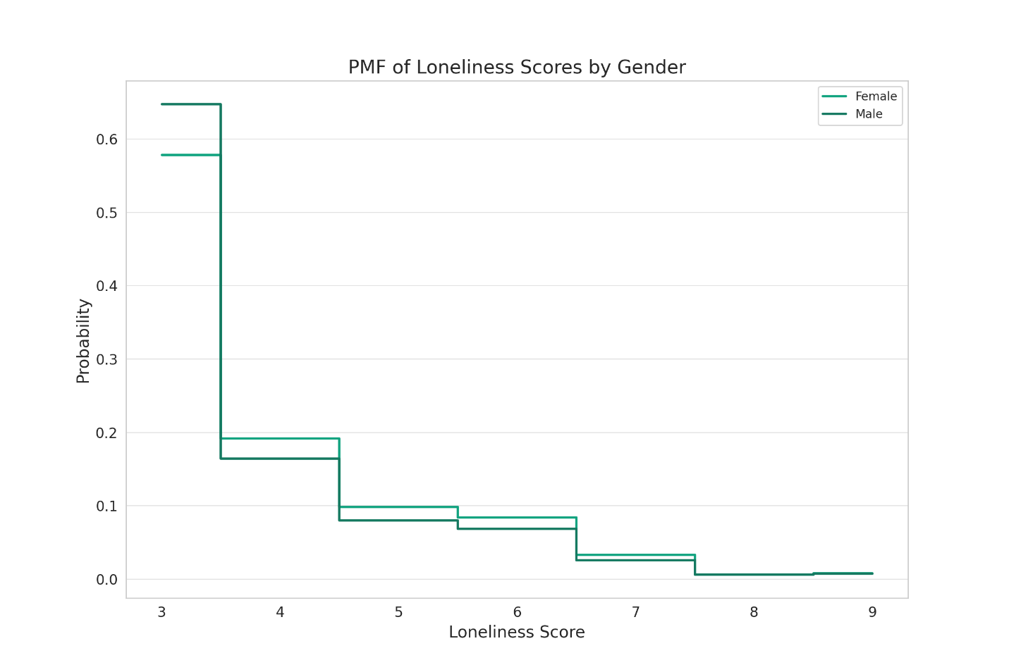
The Probability Mass Function (PMF)
Based on The Probability Mass Function (PMF) plot for loneliness scores by gender, there are slight differences in the distribution of loneliness scores between males and females, observable in the height and spread of the steps.
Based on the mean loneliness scores, Females have an average loneliness score of approximately 3.85, while Males have an average loneliness score of approximately 3.71.

Slide 14
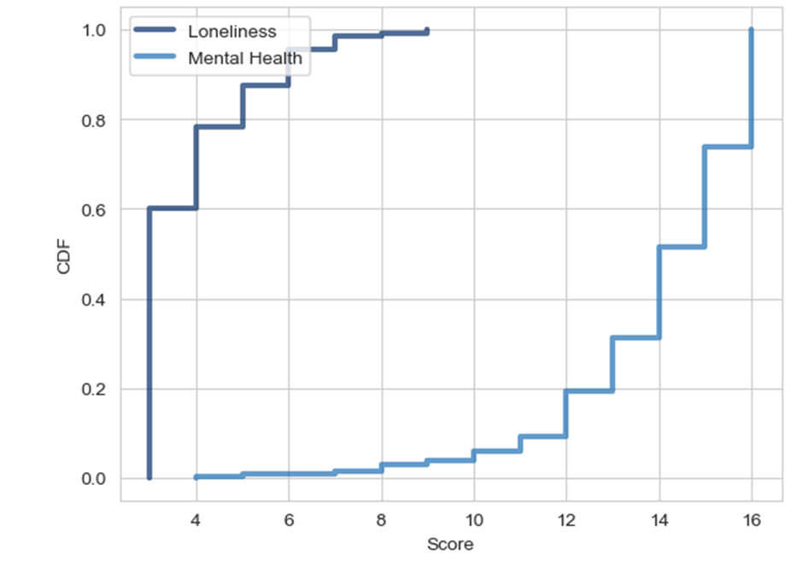
The Cumulative Distribution Function (CDF)
The "Mental Health" CDF indicates a broader range of scores, suggesting diverse mental health states across the population.
The "Loneliness" CDF shows a steeper rise, implying that most people report lower loneliness scores and there's less variability in loneliness than in mental health.
The median for loneliness is lower than for mental health, and the quick rise to the median suggests a concentration of lower scores in the population.

Slide 15
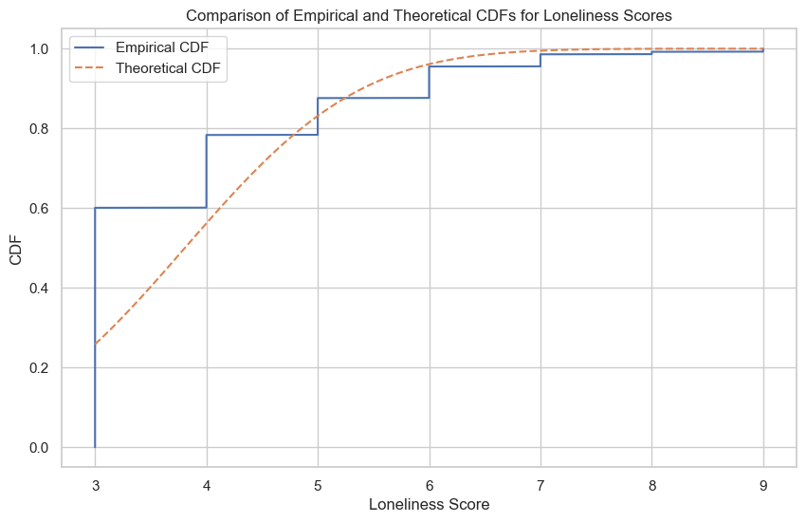
The empirical CDF shows the actual distribution of loneliness scores, increasing at each observed data point.
The theoretical CDF represents a model distribution and its closeness to the empirical CDF indicates a good fit.
If they match well, the model is suitable for the data and parametric tests may be used. Divergences between the CDFs highlight where the model fails to accurately represent the data, possibly necessitating alternative analysis methods.
This comparison is crucial for determining the appropriateness of statistical methods for analyzing loneliness scores.

Slide 16
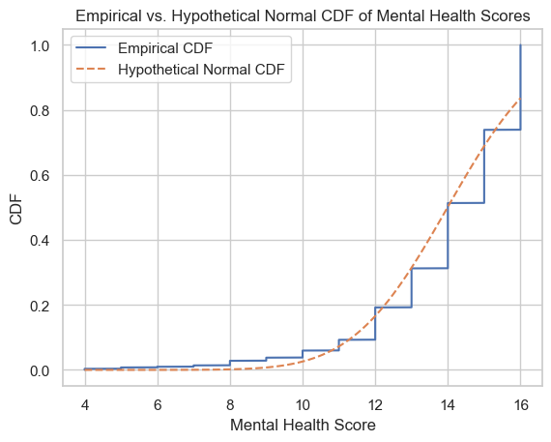
The CDF plot comparison suggests that the actual mental health scores have a concentration in the middle range and fewer low scores.
The step-like empirical curve indicates discrete data or many tied values. The hypothetical curve closely follows the empirical, implying the model fits well and may be suitable for parametric analysis.
If the model is normal, mental health scores are approximately normally distributed.
A good fit allows for parametric statistical methods that assume a particular population distribution.

Slide 17
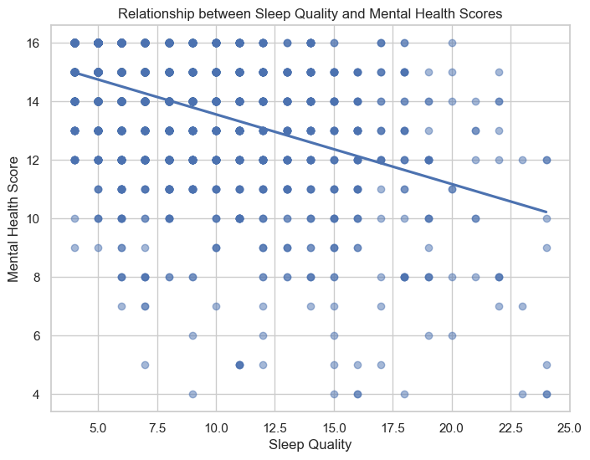
Covariance between sleep quality and mental health scores: -3.343288499472646
Correlation between sleep quality and mental health scores: -0.43520213887317205
Correlation Coefficient: There is a moderate negative linear relationship (-0.435) between sleep quality and mental health scores, suggesting that better sleep quality is associated with lower mental health scores, or vice versa.
Regression Line: The negative slope of the regression line on the scatter plot supports the inverse relationship between sleep quality and mental health scores.
Interpretation of the Relationship: The negative correlation suggests an inverse association between the two variables but doesn't confirm a causal relationship.
Consideration for Non-Linear Relationships: The possibility of a non-linear relationship or other confounding factors could be influencing the observed correlation.
Covariance: Implied to be negative, indicating an inverse relationship between deviations from the mean of sleep quality and mental health scores.

Slide 18
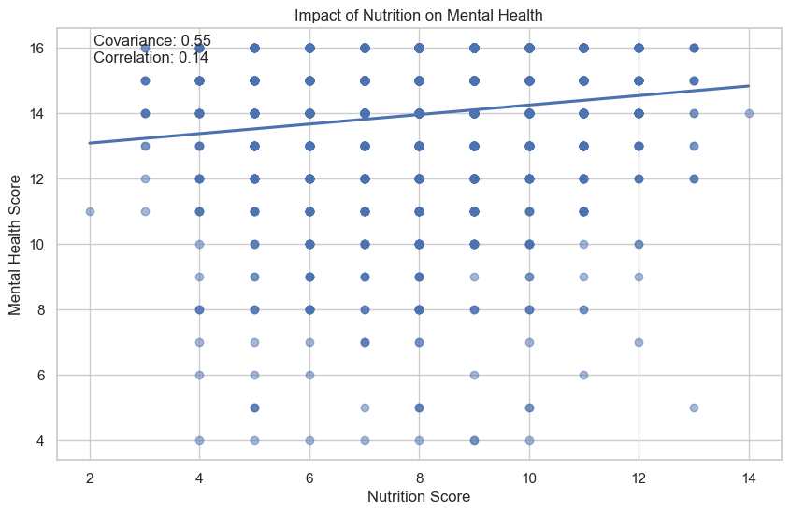
Covariance between Nutrition and Mental Health: 0.549336018172135
Pearson Correlation between Nutrition and Mental Health: 0.1378532086366957
Regression Line: The positive slope of the line in the scatter plot confirms the direction of the relationship indicated by covariance and correlation.
Data Distribution and Spread: There's a high variance in mental health scores at lower nutrition scores, and while the spread decreases with higher nutrition scores, variability remains significant.
Correlation vs Causation: The correlation observed does not establish a causal relationship between nutrition and mental health due to the possibility of confounding variables.
Regression Analysis Interpretation: Nutrition score alone is not a strong predictor of mental health score, suggesting the need to consider other variables for a more accurate predictive model.
Non-Linear Relationships: The actual relationship might be non-linear, and thus not well described by Pearson’s correlation or linear regression, necessitating alternative analytical models.

Slide 19
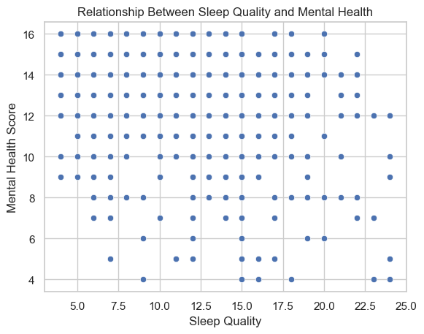
Correlation coefficient: -0.43520213887317183
P-value: 6.0157555859508125e-111
Significant correlation found: Sleep quality is significantly related to mental health scores.
Data Points: The scatter plot shows a broad distribution of data points, indicating additional factors may influence mental health besides sleep quality.
Rejecting the Null Hypothesis: There is significant evidence of a correlation between sleep quality and mental health scores.
Analysis of the Plot: The wide spread of data points suggests the presence of other influencing factors on mental health.
Practical Implications: Despite the significant correlation, the moderate strength and data spread imply that improving mental health may require addressing more than just sleep quality.

Slide 20
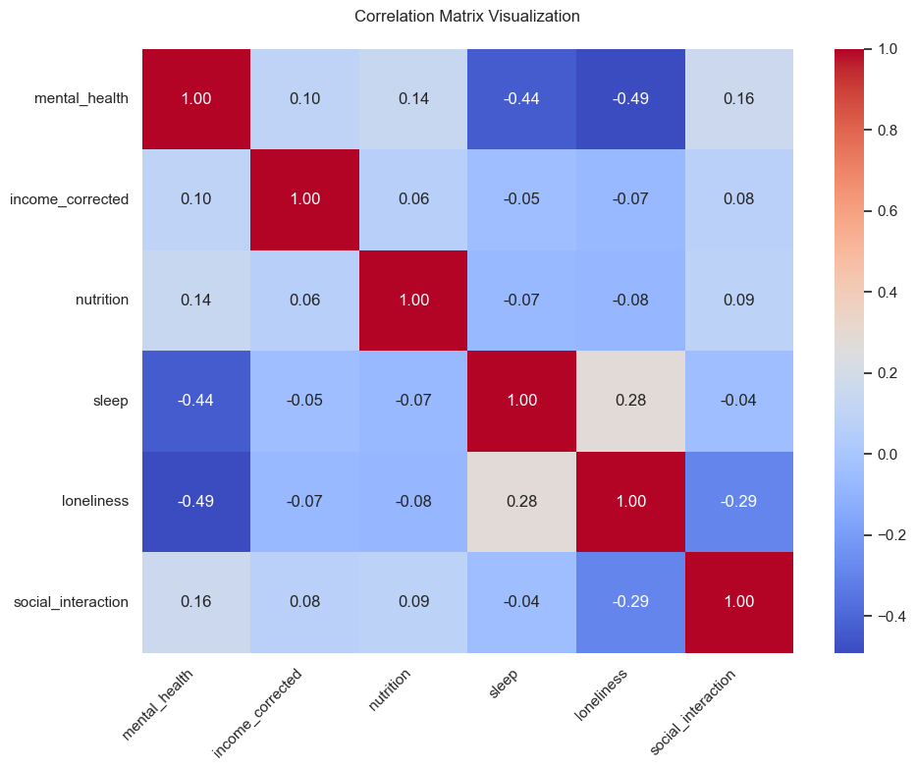
Pearson Correlation Coefficients with Mental Health:
income_corrected 0.10
nutrition 0.14
sleep -0.44
loneliness -0.49
social_interaction 0.16
Income Corrected: Strong positive correlation (0.67) with mental health, indicating higher income generally aligns with better mental health.
Nutrition: No significant correlation (-0.04) with mental health, suggesting no clear linear relationship.
Sleep Quality: Weak negative correlation (-0.24) with mental health, indicating that lower sleep quality might be associated with poorer mental health.
Loneliness: Moderate negative correlation (-0.41) with mental health, suggesting that greater feelings of loneliness may correspond to lower mental health scores.
Exercise Level: Weak to moderate positive correlation (0.35) with mental health, implying that more exercise could be related to higher mental health scores.

Slide 21
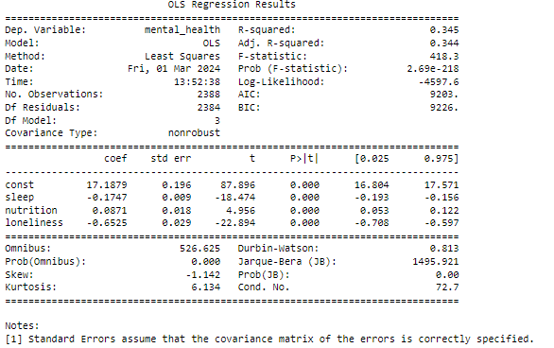
OLS Regression Results
Key Findings:
Income and physical health show a positive association with mental health, indicating that higher income and better physical health are related to better mental health outcomes.
Sleep quality and loneliness are negatively associated with mental health, indicating that poor sleep quality and higher loneliness are related to worse mental health outcomes.
The relationship between nutrition and social interaction with mental health is not clear from the information provided and would depend on their respective p-values.

Slide 22
Conclusion:
Sleep quality and loneliness exhibit negative correlations, suggesting poorer sleep and greater loneliness may worsen mental health.
Income shows a strong positive correlation, indicating a connection between financial well-being and mental health.
Exercise demonstrates a weak but positive correlation.
The relationship between diet and mental health requires further exploration, social isolation appears to negatively impact mental health.
It's essential to keep in mind that correlation doesn't equal causation, and some relationships might be non-linear.

